Slide 1

Macroeconomics of National Income Accounting
Swagat Kishore Mishra
LECTURE 26

Slide 2
Outline
National Income Estimation
Three methods of NI Accounting
Case study: Lithuania adopts 3 measures to NI accounting

Slide 3
Revenue (=GDP)
Spending (=GDP)
MARKETS FOR GOODS AND SERVICES
Good and services sold
Good and services bought
FIRMS
HOUSEHOLDS
Inputs for Production
Land, labor and capital
MARKETS FOR FACTORS OF PRODUCTION
Wages, rent, interest and profit (=GDP)
Income (=GDP)
Flow of goods & services
Flow of money: pesos
THE CIRCULAR FLOW DIAGRAM

Slide 4
Circular flow diagram
Upper loop of the circular flow diagram: transactions in the goods and services markets
Lower loop: transactions in the factor markets

Slide 5
3 Approaches for measuring GDP
Expenditure Approach (upper loop) – measures GDP as the sum of expenditures on final goods and services.
Income Approach (lower loop) – measures GDP as the sum of incomes of factors of production (wages, rent, interest and profit.
Value-added Approach – measures GDP as the sum of value added at each stage of production (from initial to final stage)

Slide 6
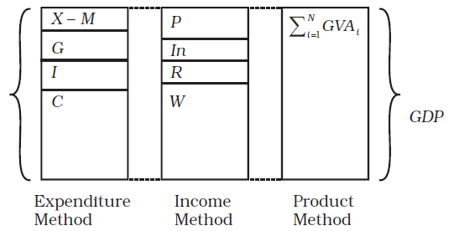
Diagramtic Representation of GDP by the Three Methods

Slide 7
Expenditure Approach
Uses the upper loop of the circular flow diagram.
Example: Suppose the economy has only one product, namely, rice.
Good | Price per unit | Q sold | Expenditure
Rice | 20 | 1000 | 20,000
 |  | GDP | 20,000

Slide 8
Income Approach
Uses the lower loop of the circular flow diagram: sum of payments to the various factors of production.
Suppose that in the production of rice the sales and expenses are as follows:
Sales |  | P 20,000
Expenses:
Wages | 8000
Rent | 4000
Interest | 2000
Total | 14,000
Profit | 6,000
GDP=Sum of Payments to factors | 20,000 | P 20,000

Slide 9
Value Added Approach
Suppose that rice is the only final product of an economy: It goes through several (3) stages of production.
Stage of Prod’n | Value of intermediate good | Value of Sales | Value-added
Farmer - Palay |  | 12,000 | 12,000
Rice Miller -Milled Rice | 12,000 | 15,000 | 3,000
Retailers - Rice | 15,000 | 20,000 | 5,000
GDP= Total Value Added |  |  | 20,000

Slide 10
Note:
The expenditure approach, income approach, and the value-added approach all come up with the same estimate of the GDP. They are equivalent approaches.
In the income approach, profit is also considered a payment to the entrepreneur. So the incomes are (1) wages, (2) rent, (3) interest, and (4) profit. Profit adjusts to make the sum equal to the final value of the good.
In the value added approach, only the value added in each stage of production are included. If we add the value of intermediate product with the value of the final product, we commit the sin of “double-counting.”
At each stage of production, the value-added is equal to wages, interest, rent, and profit. Therefore the value of the final product is likewise the same of all payments to the factors of production.

Slide 11
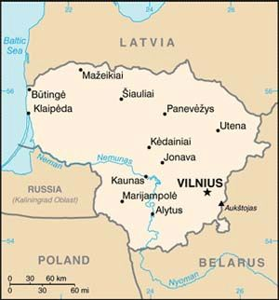
Lithuania
Economy
GDP (2010): $36 billion. GDP growth (2010): 1.3%. GDP growth (2011 forecast): 5%. Annual inflation rate (September 2011): 4.5%. Unemployment rate (second quarter of 2011): 15.6%. Average monthly earnings (first quarter of 2011): $842. Natural resources: Limestone, clay, sand, gravel, iron ore, and granite. Major sectors of the economy (2010): wholesale and retail trade, transport, and communications 33%; manufacturing 19.8%.

Slide 12
Alfred Marshall in his ‘Principle of Economics’ (1949) defines National income as
“The labour and capital of a country, acting on its natural resources, produce annually a certain net aggregate of commodities, material and immaterial, including services of all kinds…..and net income due on account of foreign investments must be added in. This is the true net National income or Revenue of the
country or the national dividend.”

Slide 13
Irving Fisher defined national income as
“The national dividend or income consists solely of services as received by the ultimate consumers,
whether from their material or from human environments. Thus, a piano or an overcoat made for me this year
is not a part of this year’s income, but an addition to capital. Only the services rendered to me during this year by these things are income.”

Slide 14
Central Statistical Organization defines National income as
“National Income is the sum of factor income earned by the normal residents of a country in the form of
wages, rent, interest and profit in an accounting year.”

Slide 15
Keynes had suggested three approaches to National Income in his famous book titled ‘The General Theory’ (1937) namely;
1. Aggregate expenditure (on consumption and investment goods) approach.
2. Factor income approach.
3. Sale proceeds minus cost approach.

Slide 16
Summary of Key Points
􀂉 National income is the sum total of all the incomes earned by a nation during a particular period of time.
􀂉 National income shows how the income is distributed between the wages, interest, profit and rents.
􀂉 National income is treated as an index of the economic activity of a nation. If national income reduces, the government will cut down the taxes so that citizens will have more income to spend.
􀂉 GNP is the measure of money income in which all kinds of goods and services produced in a country and net income from abroad, during one year are taken into consideration.
􀂉 Market price of only final products shall be taken into account, while measuring GNP.
􀂉 Goods and services rendered free of charge are not included in GNP.
􀂉 Transactions which do not arise from the production of current year are not included in GNP.
􀂉 Profits earned or losses incurred on account change in capital assets as a result of market fluctuation and illegal activities are not included in GNP.

Slide 17
There are three approaches to estimate GNP namely,
1. Income method
Wages and Salaries + Rent + Interest + Dividends + Undistributed Corporate Profits + Direct
Taxes + Mixed Income + Indirect Taxes + Depreciation + Net Income from Abroad.
2. Expenditure method
Private Consumption Expenditure + Gross Domestic Private Investment + Government
Expenditure on Goods and Services + Net Foreign Investment.
3. Value added method
The money value of all final goods and services produced at current prices during a year is taken into account.

Slide 18
GNP & NNP
􀂉 GNP at market prices refers to gross value of final goods and services produced annually by country plus net income from abroad.
􀂉 GNP at factor cost is the sum of the money value of the income produced by and accruing to the
various factors of production in one year in the country.
􀂉 National Income = C + I + G + (X – M) : where C = Consumption, I = Investment, G = Government and X is Export and M is Import.
􀂉 NNP= GNP-Depreciation.
􀂉 Net National Product at market prices is the net value of final goods and services evaluated at market prices in the course of one country.
􀂉 Net National Product at factor cost is the net output evaluated at factor price. It includes income earned by factors of production.

Slide 19
Incomes
􀂉 Private income is obtained by private individuals from any source productive or otherwise and the retained income of corporations.
􀂉 Personal income is the total income received by the individuals of a country from all source prior to direct taxes in one year.
􀂉 Disposable income or personal disposable income refers to the actual income which can be spent on consumption by individuals and families.
􀂉 Real income is nothing but the national income expressed in terms of a general level of prices of a particular year which is taken as base year.
􀂉 The average income of the people of a country in a particular year is called per-capita income for that year.

Slide 20
5th to 10th Nov, 2012 Surprise Test-1 for POE: 20 Marks (T1 + T2 Syllabus: Multiple Choice) & Surprise Test-1 for FINANCE: 10 Marks (Lecture Series 6, 7 & 8) [NO MAKE-UP EXAMINATION]

Slide 21

Thank y☺u
Pupils of Economics

